Slide 1
Quantum impurity problems (QIP) and numerical renormalization group (NRG): quick introduction
Rok Žitko
Institute Jožef Stefan
Ljubljana, Slovenia
June 2013, SISSA, Trieste, Italy

Slide 2
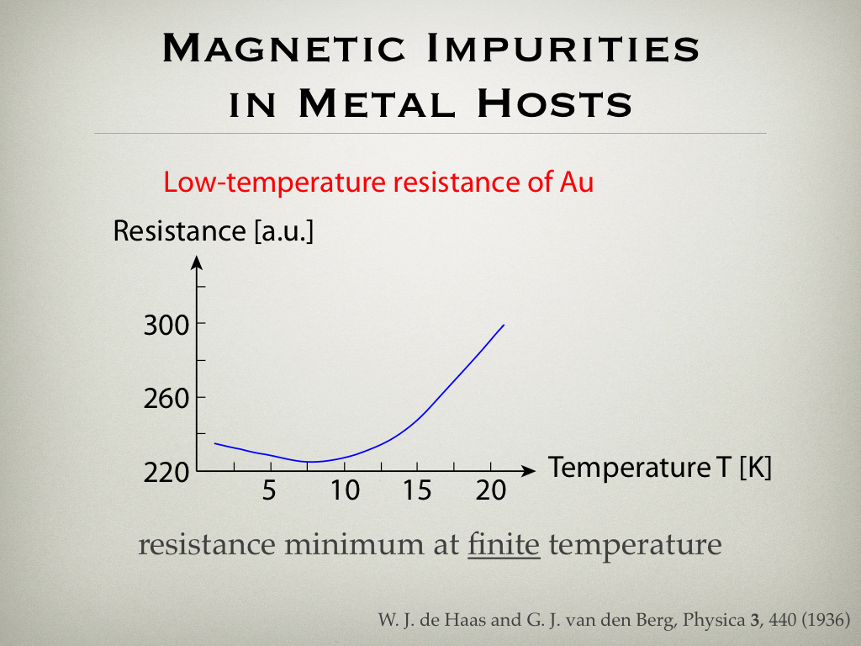
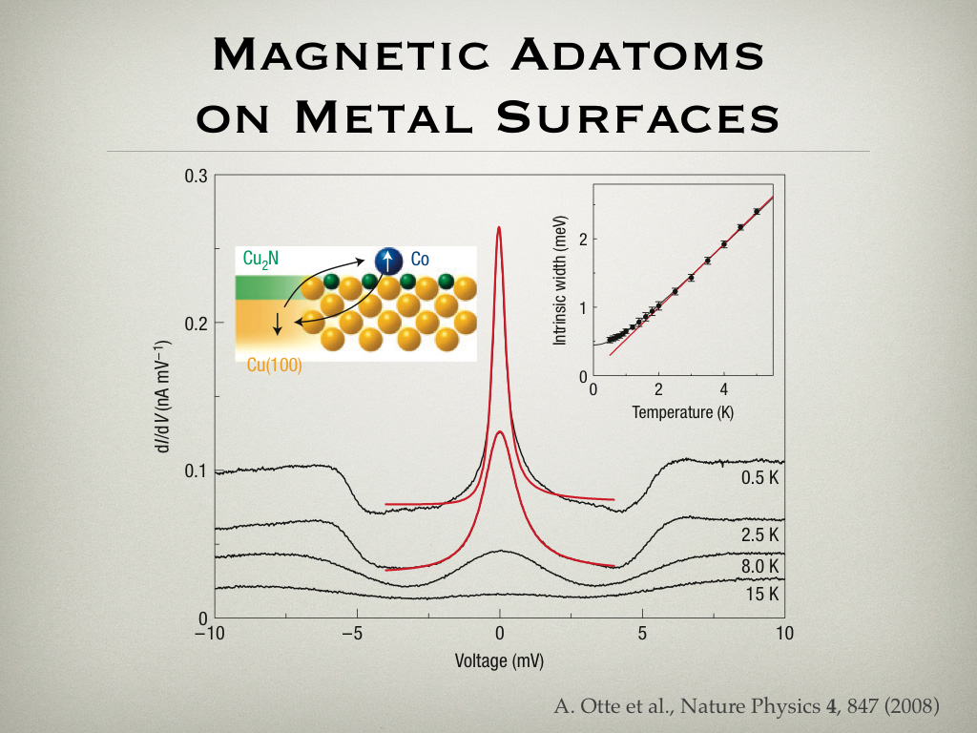
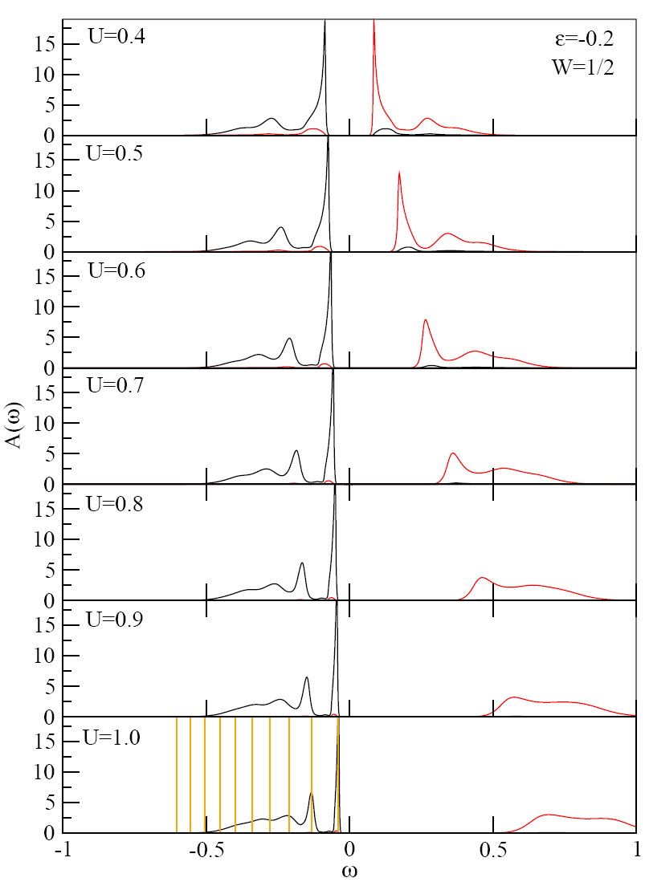
Hubbard model on the Bethe lattice,
AFM phase
spin-polaron structure
(“string-states”)

Slide 4
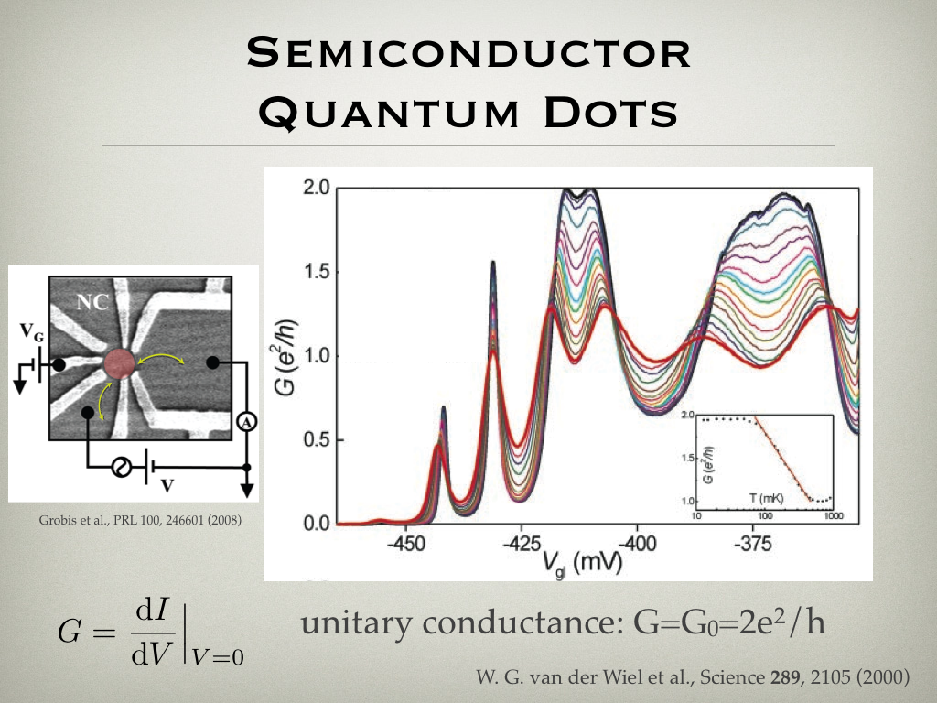

Slide 5
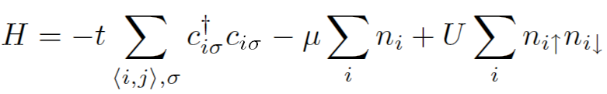
Dynamical mean-field theory
Hubbard model

Slide 6
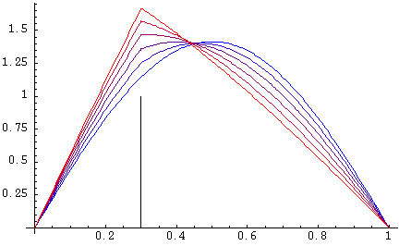
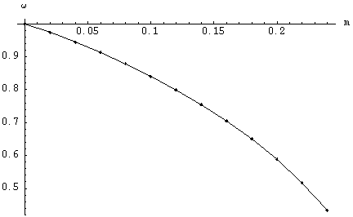
“Classical impurity” (potential scattering)
Notes:
Let us first consider a “classical” impurity: a bead of mass m on a string attached to two solid walls. How does the bead perturb the oscillation of the string?
Increase gradually the mass. What happens? String oscillation deformed, frequency decreases (more intertia). When m->0, no effect.
If you think about this problem, it is really a wave-mechanical problem. In quantum mechanics this would correspond to an electron in a potential well scattering on an additional potential scatterer.
The result remains the same: if small potential scattering, no effect.

Slide 7
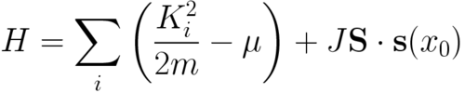

“Quantum impurity” (exchange scattering)
This is the Kondo model!
Notes:
Now let us have many electrons (number controller by the chemical potential mu), exchange scattering instead of potential scattering. In order words, quantum mechanical spin S couples with the spin-density of electrons
at its position via exchange coupling. What we thereby obtain is called the Kondo model.

Slide 8
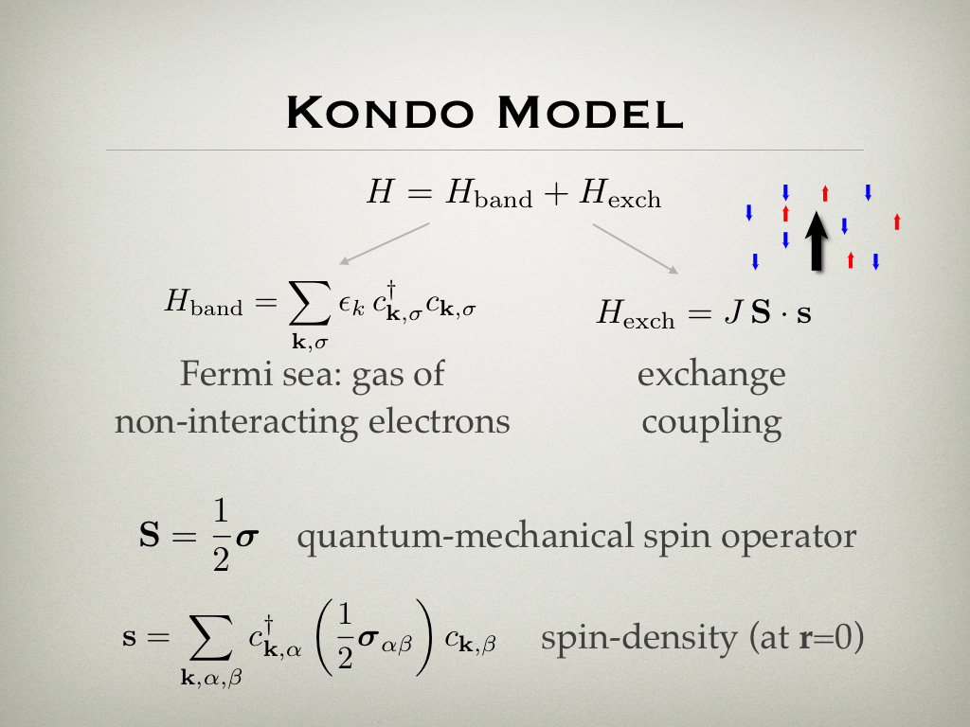

Slide 9


Nonperturbative behaviour
The perturbation theory fails for arbitrarily small J !
Notes:
To characterized the system, consider the impurity magnetization. Defined as the contribution to the total system magnetization! Common procedure for impurity models! Multiply by the concentration to obtain the final results (in the dilute limit!).
Zero order result: Curie-law behavior of a free impurity.
First order correction: linear term, as in “classical” impurity where the frequecy is a linear function of the bead mass.
Second order correction: logarithmic prefactor! The result diverges at low temperature!
Adding further terms does not help; the divergence remains.
Something interesting must happen on the scale of T_K.

Slide 10
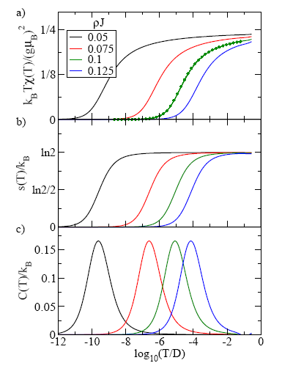
Screening of the magnetic moment
Kondo effect!
Notes:
This is what really happens (result of numerical calculations):
linear reduction at high temperatures (first term), further temperature-dependent reduction at lower energy scales, until there is a cross-over on the scale of T_K to a regime with no effective magnetic moment.
Described as screening of the impurity magnetic moment.
Mirrored also in the impurity entropy, which is reduced to zero. Below T_K, the impurity becomes a static potential scatterer for all practical purposes.

Slide 11
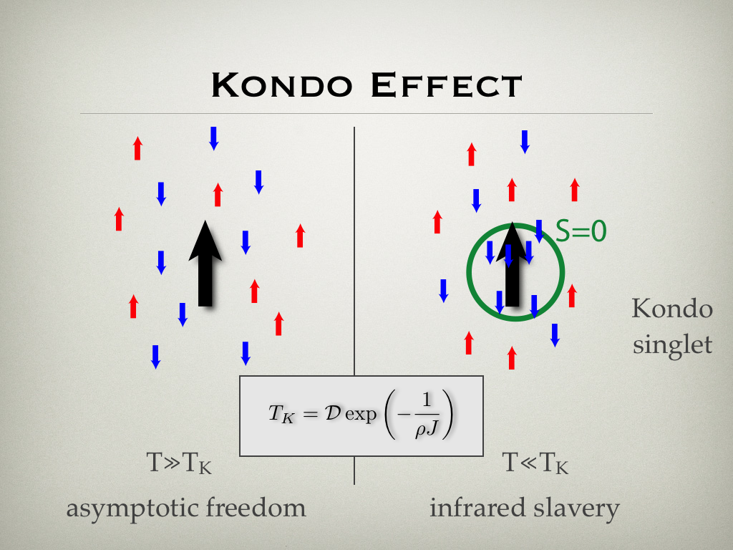
“infrared slavery”
“Asymptotic
freedom”
Analogy: T_{K} ∼ Λ_{QCD}
T >> T_{K}
T << T_{K}
Notes:
Physical picture has an analogy in particle physics, namely something similar can be found in the quark physics.
On high energy (temperature) scales, the impurity is free. Perturbation theory works.
On low energy (temperature) scales, the conduction band electrons form a singlet bound state with the impurity spin. Different theoretical description required.
Lambda_QCD=150MeV. Dimensional transmutation. Conformal symmetry of the classical theory is broken.

Slide 12
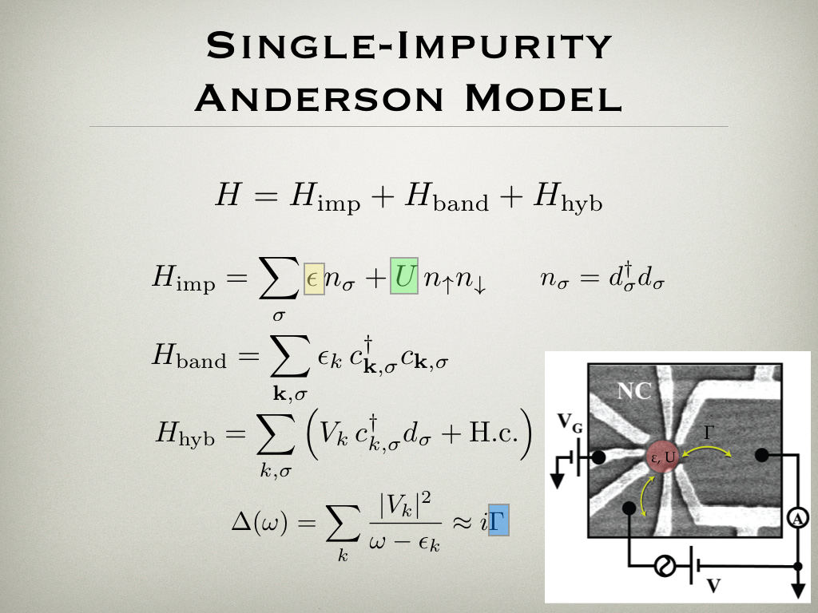

Slide 13
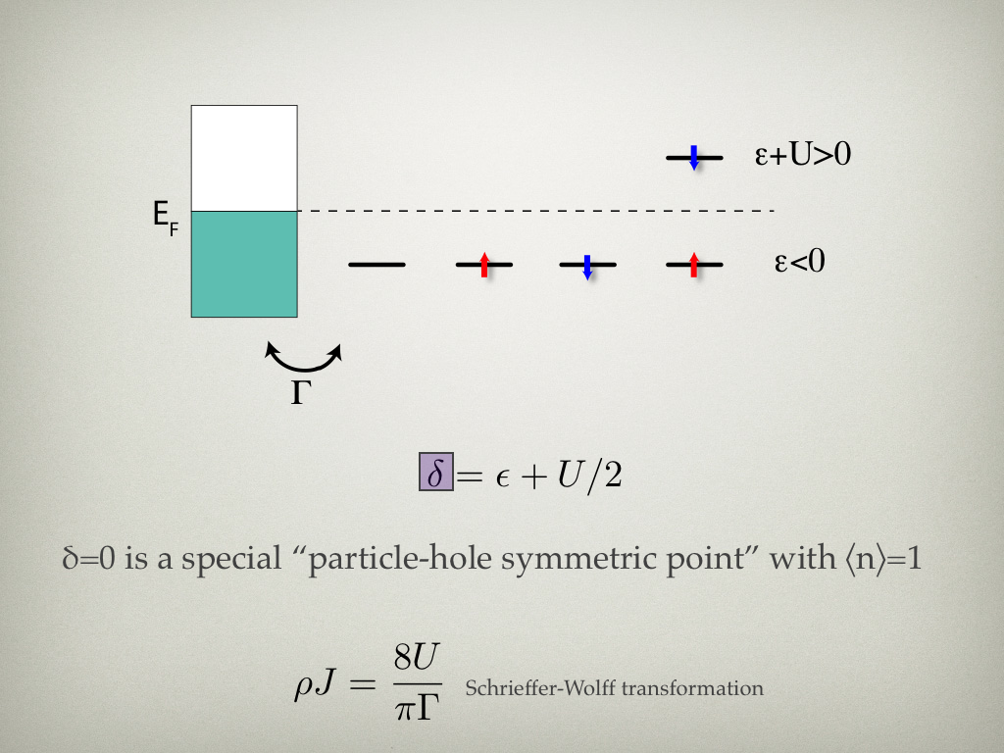

Slide 14
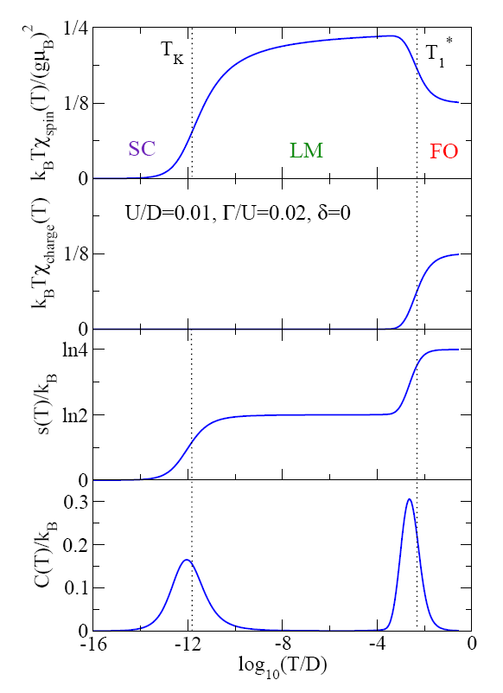
Krishnamurthy, Wilkins, Wilson, PRB 21, 1003 (1980)

Slide 15
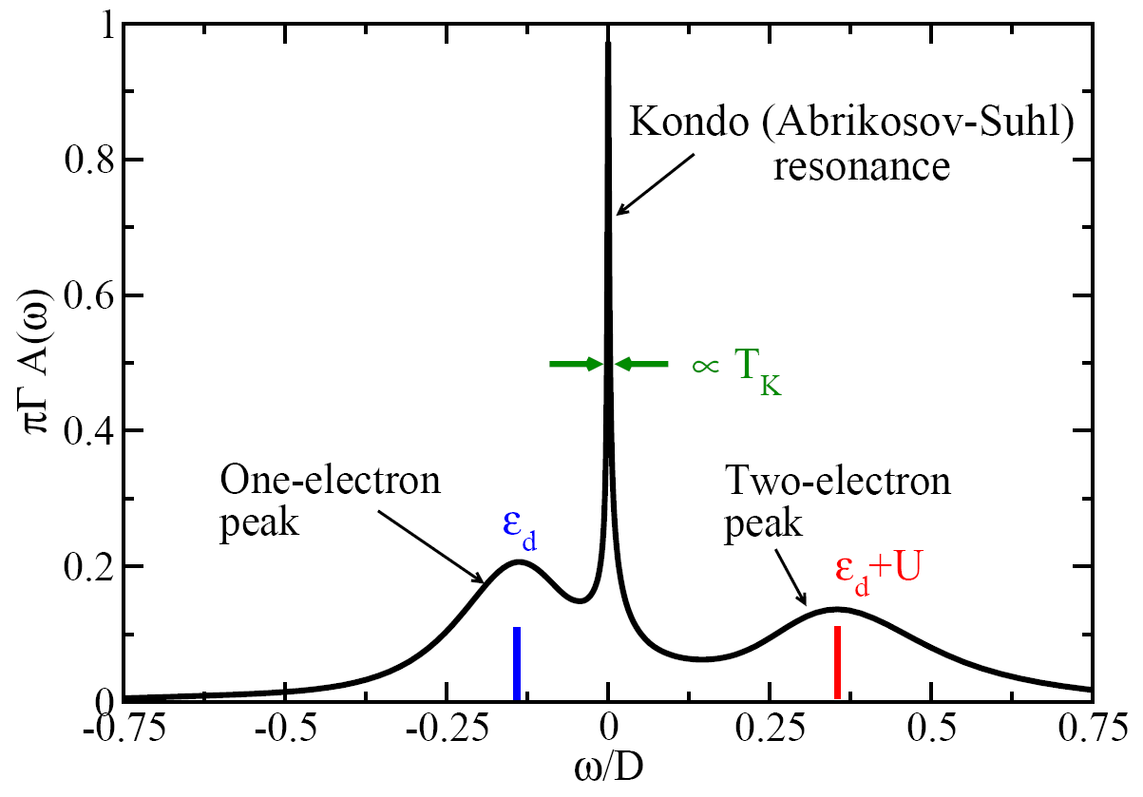
Frota, Oliveira, PRB 33, 7871 (1986), Costi, Hewson, Zlatić, JPCM 6, 2519 (1994)

Slide 16
Renormalization group theory
Energy cascading
Scaling
Amplification and deamplification
Relevant operators
Irrelevant operators
Vicinity of a fixed point
Universal behaviour
of different systems
RG explains the universality of critical phenomena in continuous phase transitions. K. G. Wilson, Nobel prize 1982.

Slide 17
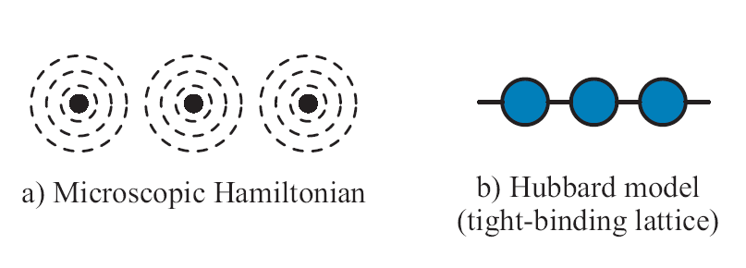
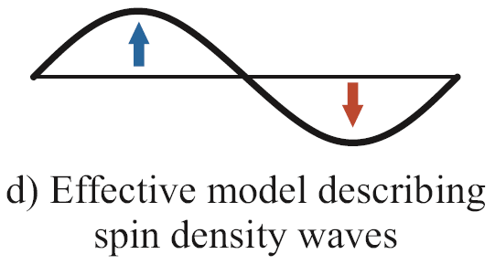
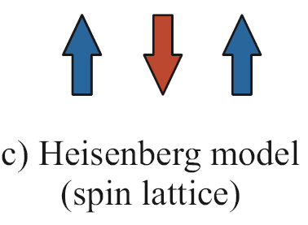
Renormalization group
?
Notes:
Ker teorija motenj odpove, se moramo naloge lotiti z močnejšimi orodji.
RG: pristop k obravnavi problemov, pri katerem se vprašamo, kako se spremeni opis fizikalnega obnašanja, če spremenimo energijsko skalo, pri
kateri sistem opazujemo. Fizika delcev: energija delcev, ki jih trkamo. Trdna snov: energija delcev, ki jih streljamo v vzorec, pa tudi temperatura.
Obe skali sta priblizno ekvivalentni.
Ilustrativen primer: kos magnetne snovi.
Auger, XPS: 1 keV, obravnavamo vsak atom zase.
Optična spektroskopija, transportne meritve: 1eV, pozabimo na globoke lupine in upoštevamo samo valenčne elektrone. Globoke lupine upoštevamo s tem, da atom
obravnavamo kot z elektroni oblečeno jedro, torej ion. To je že RG korak!
Magnetne vzbuditve (sipanje nevtronov): 100 meV. Kvantni Heisenbergov model.
Magnetni odziv (magnetna susceptibilnost, toplotna kapaciteta -- temperatura): 1 meV. Opis s klasično teorijo polja, Ginzburg-Landauove enačbe.

Slide 18
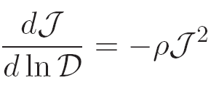
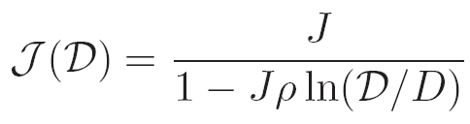
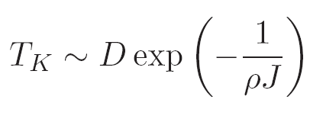
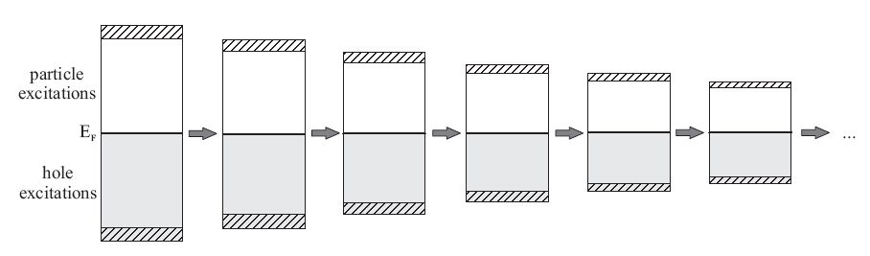
Cutoff renormalization

Slide 19
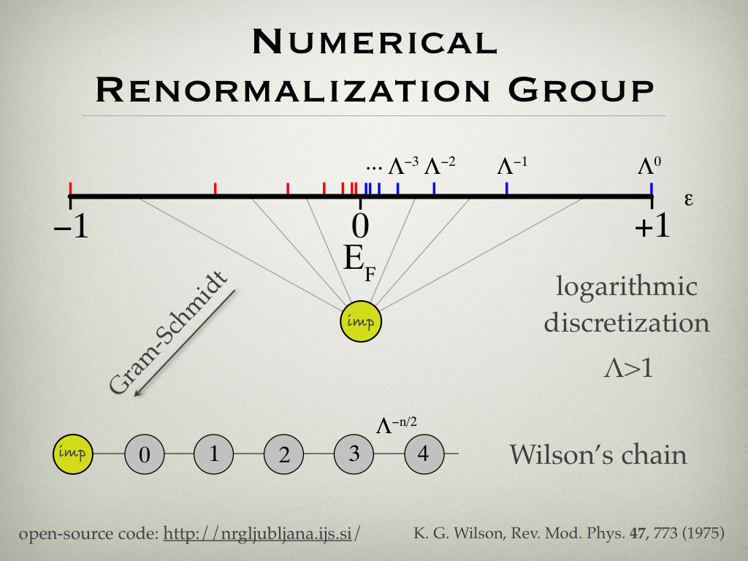

Slide 20
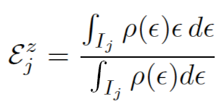
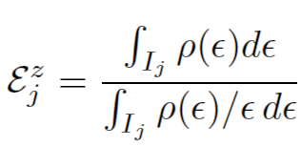

Discretization schemes
ρ(ε) = density of states in the band
1) Conventional scheme
2) Campo-Oliveira scheme
Chen, Jayaprakash, JPCM 7, L491 (1995); Ingersent, PRB 54, 11936 (1996); Bulla, Pruschke, Hewson, JPCM 9, 10463 (1997).
Campo, Oliveira, PRB 72,
104432 (2005).
3) Scheme without artifacts
R. Žitko, Th. Pruschke, PRB 79, 085106 (2009)
R. Žitko, Comput. Phys. Comm. 180, 1271 (2009)

Slide 21
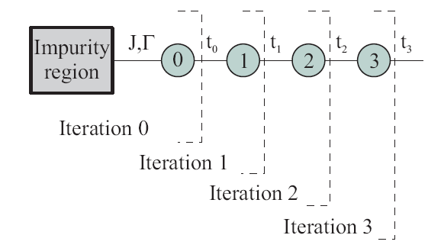
Iterative diagonalization
Recursion relation:

Slide 22
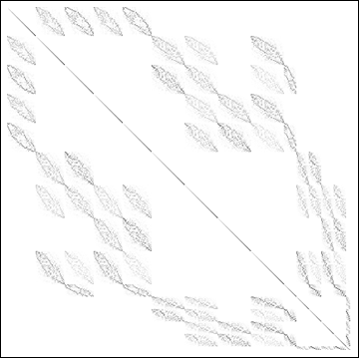
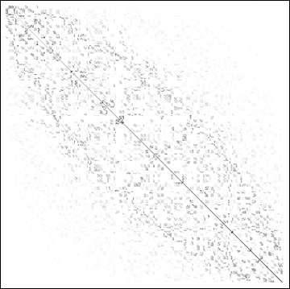
Energy-scale separation
Notes:
Zato NRG deluje. Posebna lastnost modelov kvantnih necistoc.

Slide 23
Extremely fast (for single-orbital problems)
Arbitrarily low temperatures
Real-frequency spectral functions
Arbitrary local Hamiltonian / hybridization function

Slide 24
Dynamic quantities
We’re interested in correlators such as
or their Fourier transforms
Spectral decomposition (Lehmann representation):
Frota, Oliveira, PRB 33, 7871 (1986); Sakai, Shimizu, Kasuya, JPSJ 58, 3666 (1989);
Costi, Hewson, Zlatić, JPCM 6, 2519 (1994); Hofstetter, PRL 85, 1508 (2000).

Slide 25
Patching
pΛ^{1/2}
p: patching parameter
(in units of the energy
scale at N+1-th iteration)
Bulla, Costi, Vollhardt,
PRB 64, 045103 (2001).
p
pΛ
Alternatively: complete Fock space approach.
Peters, Pruschke, Anders, PRB 74, 245114 (2006)
Weichselbaum, von Delft, PRL 99, 076402 (2007).

Slide 26
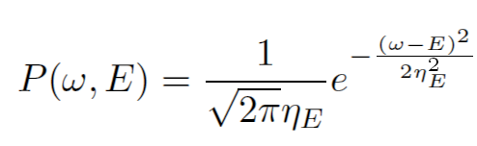
Broadening
η_{E} = η |E|

Slide 27
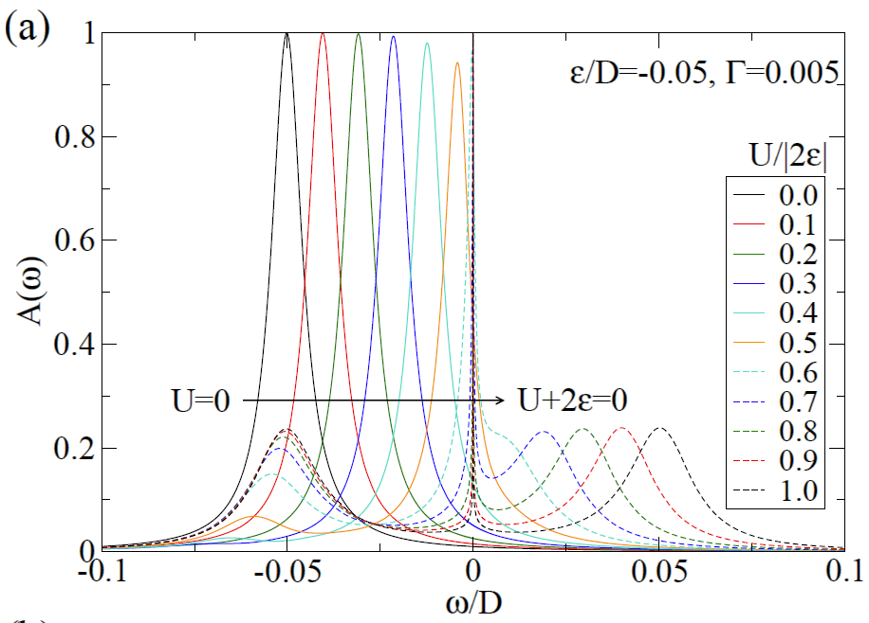
High-resolution spectral functions
Notes:
In particular, it has been possible to produce spectral functions with high resolution even at higher energies, thus even the Hubbard peaks can be described adequately.

Slide 28
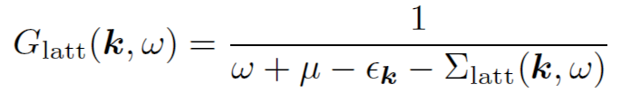

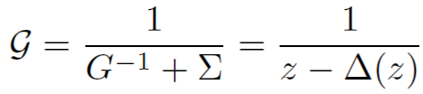
Dynamical mean-field theory
Hubbard model

Slide 29
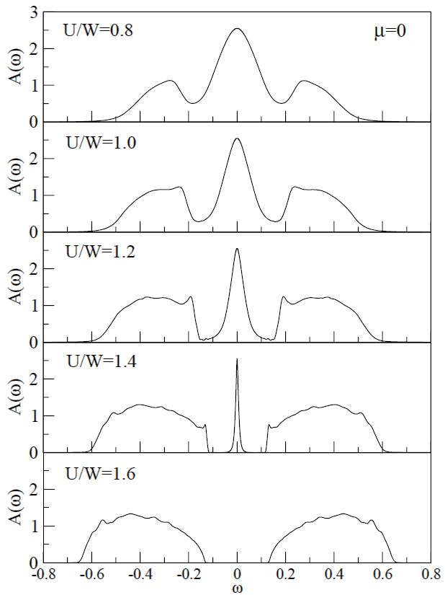
Hubbard model on the Bethe lattice,
PM phase
inner band-edge features
See also DMRG study,
Karski, Raas, Uhrig,
PRB 72, 113110 (2005).

Slide 30
Tools: SNEG and NRG Ljubljana
Add-on package for the computer algebra system Mathematica for performing calculations involving
non-commuting operators
Efficient general purpose
numerical renormalization group code
flexible and adaptable
highly optimized (partially parallelized)
easy to use
Both are freely available under the GPL licence:
http://nrgljubljana.ijs.si/

Slide 31
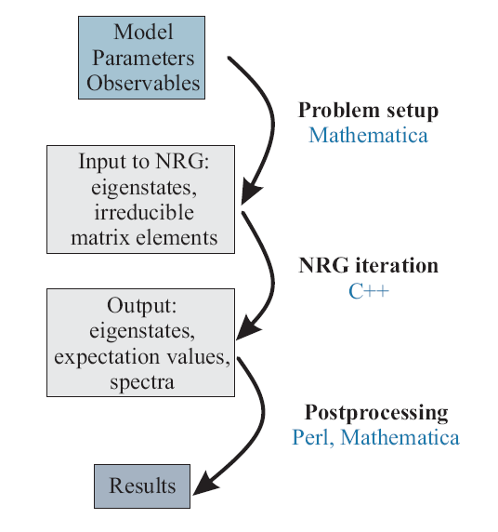
nrginit
nrgrun
various scripts
Notes:
postprocessing: z averaging, etc.

Slide 32
Lectures plan
1a. Introduction to QIP and NRG
1b. Discretization, z-averaging, thermodynamics, flow diagrams
2a. Implementing NRG, handling second quantization expressions, parallelization issues
2b. Tutorial: getting the code to run, basic calculations
3a. Spectral function calculations, self-energy trick, DMNRG, patching, complex Fock space basis approaches
3b. Tutorial: themodynamics and flow diagrams for Kondo model and SIAM
4a. More on spectral functions: systematic errors, broadening issues
4b. Tutorial: spectral function for SIAM, T matrix for Kondo model

Slide 33
5a. Transport properties
5b. Tutorial: Kondo peak splitting in magnetic field, transport properties, conductance and thermopower in SIAM
6a. NRG as impurity solver in dynamical mean-field theory, self-consistency, Broyden mixing
6b. Tutorial: Hubbard model, MIT at half-filling, bad metal behavior
7a. Underscreening, overscreening, (singular,regular,non)-Fermi liquids
7b. Tutorial: S=1 Kondo model, two-channel Kondo model
Optional: phonons, impurities in superconductors, multi-impurity models

Slide 34
Reference works
Wilson, RMP 1975
Krishnamurthy, Wilkins, Wilson, 2xPRB 1980
Hofstetter, PRL 2000
Anders, Schiller, Peters, Pruschke, Weichselbaum, von Delft, several papers, 2005-2008
Bulla, Costi, Pruschke, RMP 2008

